Slide 1
CRYPTOCURRENCY TODAY
Here is where your presentation begins

Slide 2
CONTENTS OF THIS TEMPLATE
Here’s what you’ll find in this Slidesgo template:
A slide structure based on a newsletter, which you can easily adapt to your needs. For more info on how to edit the template, please visit Slidesgo School or read our FAQs.
An assortment of graphic resources that are suitable for use in the presentation can be found in the alternative resources slides.
A thanks slide, which you must keep so that proper credits for our design are given.
A resources slide, where you’ll find links to all the elements used in the template.
Instructions for use.
Final slides with:
The fonts and colors used in the template.
A selection of illustrations. You can also customize and animate them as you wish with the online editor. Visit Storyset to find more.
More infographic resources, whose size and color can be edited.
Sets of customizable icons of the following themes: general, business, avatar, creative process, education, help & support, medical, nature, performing arts, SEO & marketing, and teamwork.
You can delete this slide when you’re done editing the presentation.

Slide 3
TABLE OF CONTENTS
01
04
02
05
03
ANNOUNCEMENTS
WELCOME!
You can describe the topic of the section here
You can describe the topic of the section here
IN DEPTH
EVENTS
You can describe the topic of the section here
You can describe the topic of the section here
IN BRIEF
You can describe the topic of the section here

Slide 4
WHOA!
This can be the part of the presentation where you can introduce yourself, write your email…

Slide 5
01
ANNOUNCEMENT
You can enter a subtitle here if you need it

Slide 6
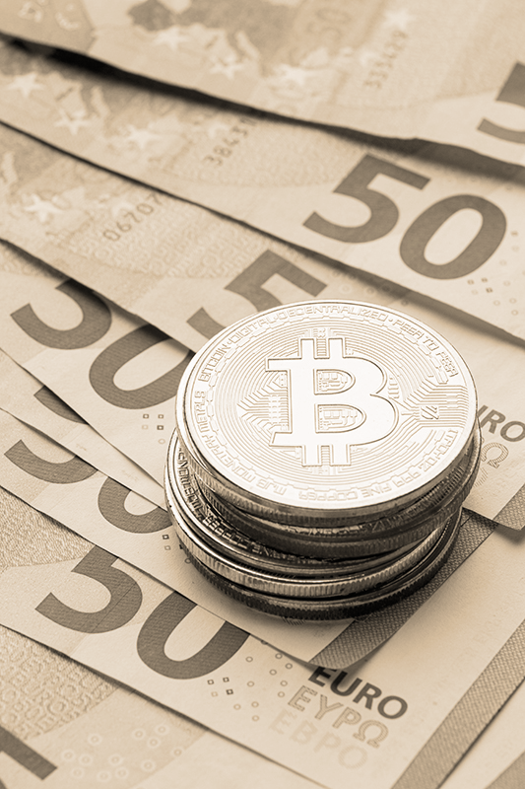
A PICTURE ALWAYS REINFORCES THE CONCEPT
Images reveal large amounts of data, so remember: use an image instead of a long text

Slide 7
—SOMEONE FAMOUS
“This is a quote, words full of wisdom that someone important said and can make the reader get inspired”

Slide 8
1ST ANNOUNCEMENT
Venus has a beautiful name and is the second planet from the Sun. It’s terribly hot, even hotter than Mercury

Slide 9
2ND ANNOUNCEMENT
VENUS
Venus is the second planet from the Sun
MERCURY
MARS
Mercury is the closest
to the Sun
Despite being red, Mars is a cold place

Slide 10
02
IN DEPTH
You can enter a subtitle here if you need it

Slide 11
IN DEPTH
Do you know what helps you make your point clear? Lists like this:
They’re simple
You can organize your ideas
You’ll never forget to buy milk!
And the audience won’t miss the point
of your presentation

Slide 12
SECTOR NEWS
MARS
Despite being red, Mars is actually a cold place full of iron oxide dust
NEPTUNE
Neptune is the farthest planet from the Sun and the fourth-largest

Slide 13

IN DEPTH
JUPITER 35%
It’s a gas giant and the
biggest planet in the entire Solar System
MARS 25%
Despite being red, Mars is actually a cold place full of iron oxide dust
NEPTUNE 40%
Neptune is the farthest planet from the Sun and the fourth-largest
Follow the link in the graph to modify its data and then paste the new one here. For more info, click here

Slide 14
PERCENTAGES
35%
60%
83%
MERCURY
MARS
VENUS
Mercury is the smallest planet in the Solar System
Despite being red, Mars is actually a cold place
It has a beautiful name and is the second planet

Slide 15
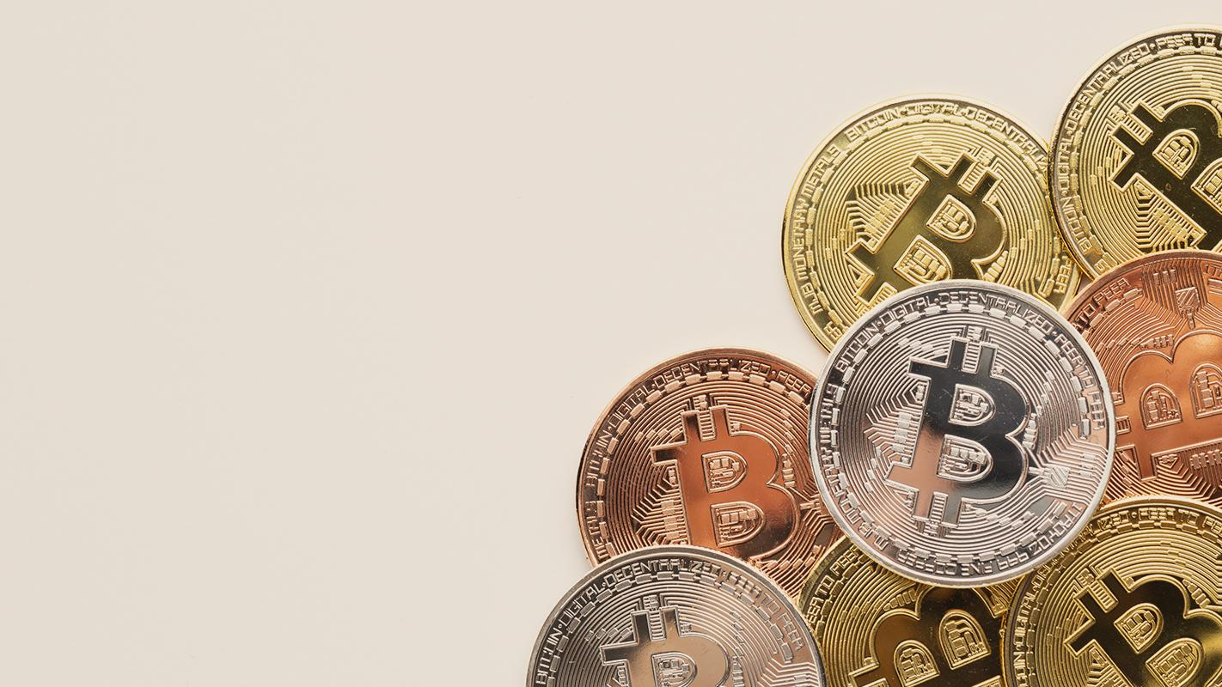
A PICTURE IS WORTH A THOUSAND WORDS

Slide 16
03
IN BRIEF
You can enter a subtitle here if you need it

Slide 17
NEWS
LOYALTY
EFFICIENCY
Mercury is the closest planet to the Sun
Mars is actually a very cold place
RELIABILITY
COMMITMENT
It has a beautiful name and is the second planet
Jupiter is a gas giant and the biggest planet

Slide 18
CUSTOMER REVIEWS
JENNA SMITH
“Mercury is the closest planet to the Sun and also the smallest one”
JOHN DOE
“Neptune is the farthest planet from the Sun and the fourth-largest”

Slide 19
WELCOME!
Venus has a beautiful name and is the second planet from the Sun. It’s terribly hot—even hotter than Mercury—and its atmosphere is extremely poisonous

Slide 20
04
WELCOME!
You can enter a subtitle here if you need it

Slide 21
AWESOME WORDS

Slide 22
4,897
Big numbers catch your audience’s attention

Slide 23
05
EVENTS
You can enter a subtitle here if you need it

Slide 24
REVIEW OF PAST EVENTS
NEPTUNE
Neptune is the farthest from the Sun
VENUS
It has a nice name, but It’s terribly hot

Slide 25
REVIEW OF PAST EVENTS
JUPITER
VENUS
NEPTUNE 60%
MERCURY
Neptune is the farthest planet from the Sun

Slide 26
TYPE OF EVENTS
 | TYPE 1 | TYPE 2
VENUS | Neptune is very far away | It’s the second planet from the Sun
JUPITER | Earth is the planet where we live on | Mars is actually a very cold place
MARS | Saturn is a gas giant and has rings | It’s the closest planet to the Sun

Slide 27
UPCOMING EVENTS
JUNE 30
AUGUST 10
Neptune is the farthest from the Sun
Venus is the second planet from the Sun
JULY 20
Despite being red, Mars is a cold place

Slide 28
LATEST NEWS
MERCURY
VENUS
MARS
Mercury is the closest to the Sun
Venus is the second planet from the Sun
Despite being red, Mars is a cold place
SATURN
NEPTUNE
JUPITER
Saturn is a gas giant and has several rings
Neptune is the farthest from the Sun
It’s the biggest planet in the Solar System

Slide 29
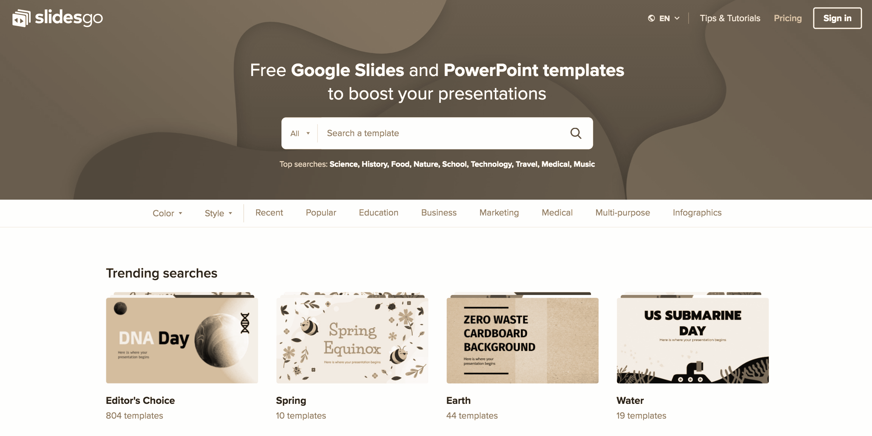
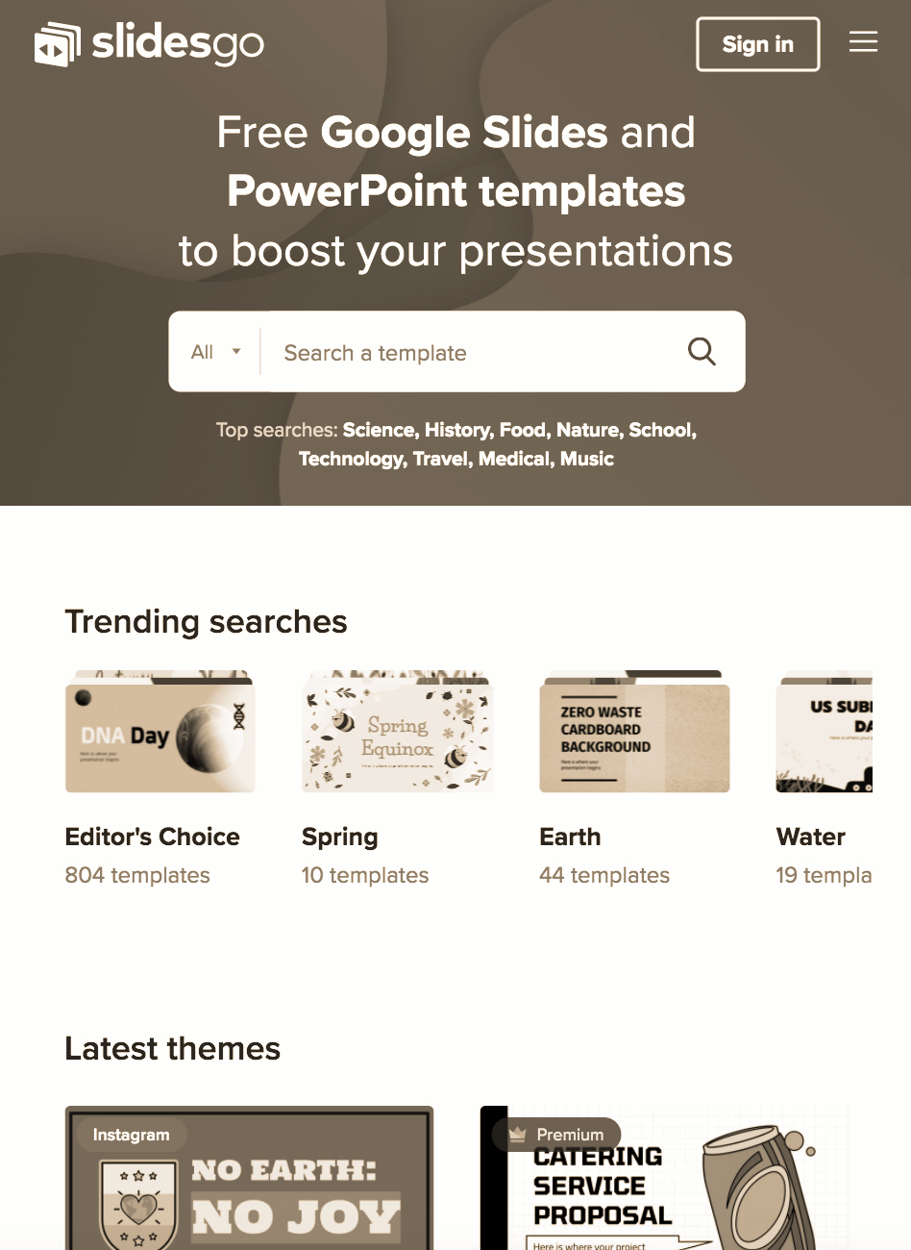
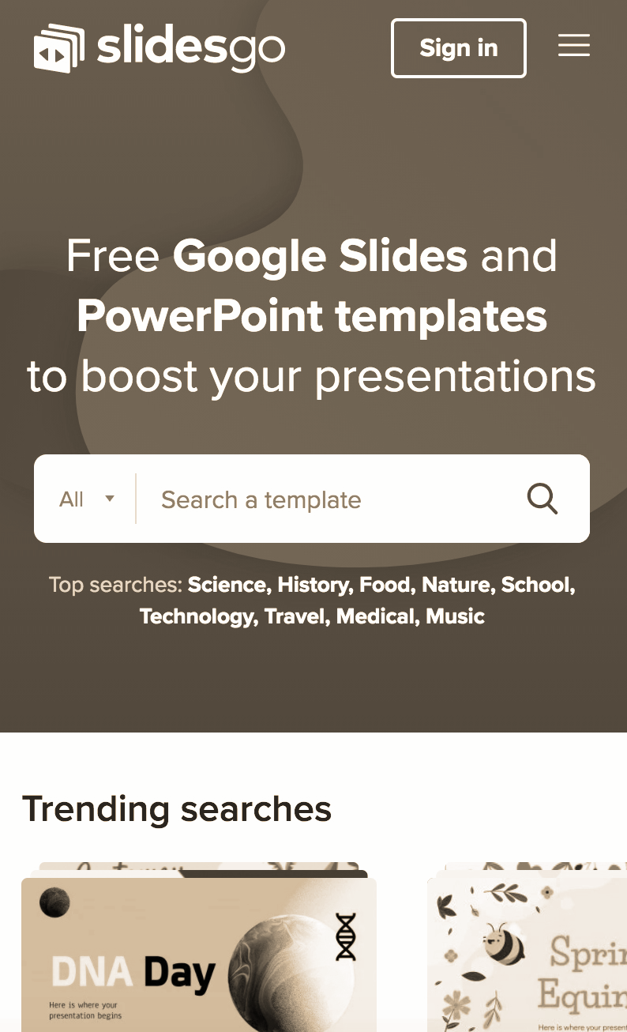
ONLINE PLATFORM
You can replace the images on the screen with your own work. Just delete these ones and add yours

Slide 30
THANKS!
Do you have any questions?
addyouremail@freepik.com | +91 620 421 838 | yourcompany.com
Please keep this slide for the attribution

